Slide 1
Child poverty in Canada
Name-Jagminder Singh
Student ID-

Slide 2
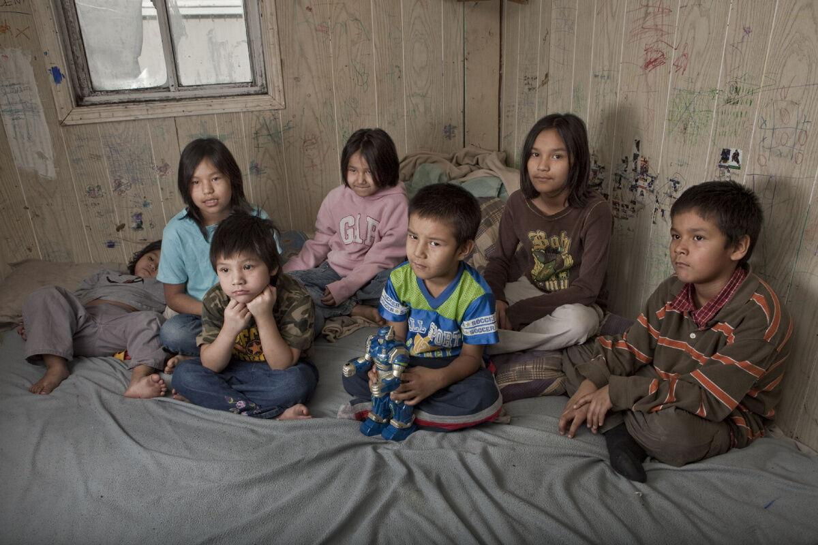
Introduction
Child poverty is considered as a major issue in Canada affecting the well-being of children in the country. There are number of issues which creates adverse impact on the children such as poor health and financial difficulties etc. There are various organisations present in Canada that provide assistance to these children and their parents

Slide 3
Child Poverty Statistics in Canada
In 2015,1.2 million children lived in below the poverty line Canadian households.
In 2020, the child poverty rate increased to 15.2%.
Recent data from 2024 shows a decrease in the child poverty rate to 9.7%, attributed to increased government transfers, including the CCB and pandemic relief benefits
The rate of child poverty demonstrates regional differences, from 14 percent in Quebec to an alarming 38 percent in the territories

Slide 4
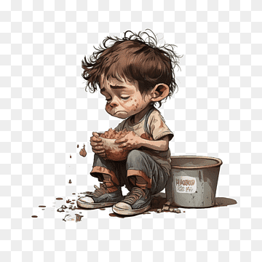
Challenges
Poor health outcome
Child poverty in Canada results in poor health outcomes including type two diabetes and asthma
High mortality rate cost due to respiratory problems and cardiovascular disease etc.
Reduced academic achievement
Cognitive development of children decreases due to poverty line
Poor children performance is less in comparison with middle class people

Slide 5
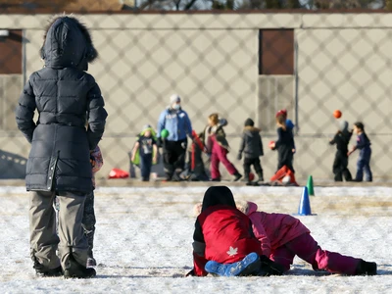
Challenges (Continue..)
Social stigma and discrimination
Inequality due to societal attitudes
Depriving children of the dignity and making them feel alienated

Slide 6


Local organizations that could support the group
Pathways to Education:
Established in 2001 in Regent Park, Toronto, to solve the educational gaps..
Motive to eliminate the poverty by empowering at-risk youth to graduate and pursue further education or training.
Canadian Feed The Children
Founded in 1986 to alleviate food insecurity and improve children's lifestyles.

Slide 7
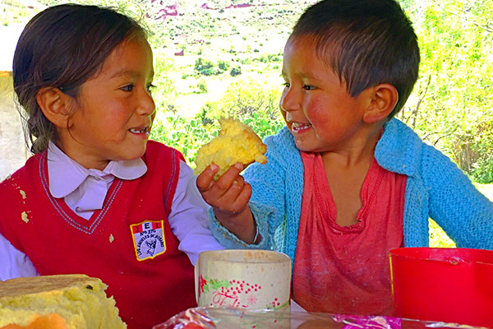
Conclusion
Addressing child poverty needs a comprehensive approach which focuses on providing everyone with equally opportunity and giving priority to the children. Organisation such as pathways to education and Canadian feed. The children are important in providing support so that these issues can be resolved.

Slide 8
References
ANZOVINO, T., ORESAR, J., & BOUTILIER, D. (2019). Walk a mile a journey towards Justice and equity in Canadian society 2nd edition Anzovino Test Bank. Issuu. https://issuu.com/jeannevt97/docs/walk-a-mile-a-journey-towards-justice-and-equity-i
Bush, O. (2024, January 9). Poverty statistics in Canada. Made in CA.https://madeinca.ca/poverty-statistics-canada/
Canada, E. and S. D. (2022, April 7). Government of Canada. Canada.ca.https://www.canada.ca/en/employment-social-development/programs/poverty-reduction/national-advisory-council/reports/2021-annual.html
Centers for Disease Control and Prevention. (2022, August 19). Health and academics. Centers for Disease Control and Prevention.https://www.cdc.gov/healthyschools/health_and_academics/index.htm
Children’s Charity Canada. Canadian Feed The Children. (2022, November 21). https://canadianfeedthechildren.ca/who/
Cotrina, L. (2018, November 9). Organizations that are working towards ending poverty in Canada. Canadian Living. https://www.canadianliving.com/life-and-relationships/community-and-current-events/article/organizations-that-are-working-towards-ending-poverty-in-canada
Meisel, M. K., Haikalis, M., Colby, S. M., & Barnett, N. P. (2022, February 8). Education-based stigma and discrimination among young adults not in 4-year college - BMC psychology. BioMed Central.https://bmcpsychology.biomedcentral.com/articles/10.1186/s40359-022-00737-4
Young, L. (2017, September 13). 1.2 million Canadian children living in poverty: Census - national. Global News.https://globalnews.ca/news/3739960/canadian-census-children-poverty/
Zhang, X., & Bernard, A. (2022, November 9). This census in brief article focuses on the experiences of poverty in Canada based on data from the 2021 census. it examines disaggregated poverty trends by age, gender, family situation, immigration status as well as by indigenous identity and for racialized groups. when possible, comparisons are made to data from the 2016 census. Government of Canada, Statistics Canada. https://www12.statcan.gc.ca/census-recensement/2021/as-sa/98-200-X/2021009/98-200-X2021009-eng.cfm

